Slide 1
Lecture 2
Lexical Analysis 2-3

Slide 2
Content Structure
Inductive method
NFA
subset construction
Regular
expressions
DFA
Minimizing
Table-driven method
General method
Lexical
Specification
Code

Slide 3
Outline
Lexical Analysis
Scanning Process
Regular Expressions
Finite Automata (NFA and DFA)
RE to NFA
From NFA to DFA
Minimizing DFA

Slide 4
Implementing Regular Expressions
Regular expressions can be implemented using finite automata.
There are two main kinds of finite automata:
NFAs (nondeterministic finite automata), which we'll see in a second, and
DFAs (deterministic finite automata), which we'll see later.
Automata are best explained by example...

Slide 5
Finite Automata State Graphs
A state
The start state
start
An accepting state
a
A transition

Slide 6
A Simple Automaton
A,B,C,...,Z
start
"
"

Slide 7
A Simple Automaton
A,B,C,...,Z
start
"
"
Each circle is a state of the
automaton. The automaton's
configuration is determined
by what state(s) it is in.

Slide 8
A Simple Automaton
A,B,C,...,Z
start
"
"
These arrows are called
transitions . The automaton
changes which state(s) it is
in by following transitions.

Slide 9
A Simple Automaton
A,B,C,...,Z
start
"
"
" H E Y A "
The automaton takes a String as
input and decides whether to accept or reject the string.

Slide 10
A Simple Automaton
A,B,C,...,Z
start
"
"
" H E Y A "

Slide 11
A Simple Automaton
A,B,C,...,Z
start
"
"
" H E Y A "

Slide 12
A Simple Automaton
A,B,C,...,Z
start
"
"
" H E Y A "

Slide 13
A Simple Automaton
A,B,C,...,Z
start
"
"
" H E Y A "

Slide 14
A Simple Automaton
A,B,C,...,Z
start
"
"
" H E Y A "

Slide 15
A Simple Automaton
A,B,C,...,Z
start
"
"
" H E Y A "

Slide 16
A Simple Automaton
A,B,C,...,Z
start
"
"
" H E Y A "

Slide 17
A Simple Automaton
A,B,C,...,Z
start
"
"
" H E Y A "

Slide 18
A Simple Automaton
A,B,C,...,Z
start
"
"
" H E Y A "

Slide 19
A Simple Automaton
A,B,C,...,Z
start
"
"
" H E Y A "

Slide 20
A Simple Automaton
A,B,C,...,Z
start
"
"
" H E Y A "
The double circle indicates that this state is an accepting state. The automaton accepts the string if it ends in an accepting state.

Slide 21
A Simple Automaton
A,B,C,...,Z
start
"
"
" " " " " "

Slide 22
A Simple Automaton
A,B,C,...,Z
start
"
"
" " " " " "

Slide 23
A Simple Automaton
A,B,C,...,Z
start
"
"
" " " " " "

Slide 24
A Simple Automaton
A,B,C,...,Z
start
"
"
" " " " " "

Slide 25
A Simple Automaton
A,B,C,...,Z
start
"
"
" " " " " "

Slide 26
A Simple Automaton
A,B,C,...,Z
start
"
"
" " " " " "

Slide 27
A Simple Automaton
A,B,C,...,Z
start
"
"
" " " " " "
There is no transition on “
here, so the automaton
dies and rejects.

Slide 28
A Simple Automaton
A,B,C,...,Z
start
"
"
" " " " " "
There is no transition on “
here, so the automaton
dies and rejects.

Slide 29
A Simple Automaton
A,B,C,...,Z
start
"
"
" A B C

Slide 30
A Simple Automaton
A,B,C,...,Z
start
"
"
" A B C

Slide 31
A Simple Automaton
A,B,C,...,Z
start
"
"
" A B C

Slide 32
A Simple Automaton
A,B,C,...,Z
start
"
"
" A B C

Slide 33
A Simple Automaton
A,B,C,...,Z
start
"
"
" A B C

Slide 34
A Simple Automaton
A,B,C,...,Z
start
"
"
" A B C

Slide 35
A Simple Automaton
A,B,C,...,Z
start
"
"
" A B C
This is not an accepting
state, so the automaton
rejects.

Slide 36
A More Complex Automaton
1
0
0
1
0
1
start
0, 1

Slide 37
A More Complex Automaton
1
0
0
1
0
1
start
0, 1
Notice that there are multiple
transitions defined here on 0 and 1.
If we read a 0 or 1 here, we follow both
transitions and enter multiple states.

Slide 38
A More Complex Automaton
1
0
0
1
0
1
start
0, 1
0 1 1 1 0 1

Slide 39
A More Complex Automaton
1
0
0
1
0
1
start
0, 1
0 1 1 1 0 1

Slide 40
A More Complex Automaton
1
0
0
1
0
1
start
0, 1
0 1 1 1 0 1

Slide 41
A More Complex Automaton
1
0
0
1
0
1
start
0, 1
0 1 1 1 0 1

Slide 42
A More Complex Automaton
1
0
0
1
0
1
start
0, 1
0 1 1 1 0 1

Slide 43
A More Complex Automaton
1
0
0
1
0
1
start
0, 1
0 1 1 1 0 1

Slide 44
A More Complex Automaton
1
0
0
1
0
1
start
0, 1
0 1 1 1 0 1

Slide 45
A More Complex Automaton
1
0
0
1
0
1
start
0, 1
0 1 1 1 0 1

Slide 46
A More Complex Automaton
1
0
0
1
0
1
start
0, 1
0 1 1 1 0 1

Slide 47
A More Complex Automaton
1
0
0
1
0
1
start
0, 1
0 1 1 1 0 1

Slide 48
A More Complex Automaton
1
0
0
1
0
1
start
0, 1
0 1 1 1 0 1

Slide 49
A More Complex Automaton
1
0
0
1
0
1
start
0, 1
0 1 1 1 0 1

Slide 50
A More Complex Automaton
1
0
0
1
0
1
start
0, 1
Since we are in at least
one accepting state, the
automaton accepts.
0 1 1 1 0 1

Slide 51
An Even More Complex Automaton
a, b
c
ε
a, c
b
start
ε
b, c
ε
a

Slide 52
An Even More Complex Automaton
a, b
c
ε
a, c
b
start
ε
b, c
ε
a
These are called ε-transitions. These
transitions are followed automatically and
without consuming any input.

Slide 53
An Even More Complex Automaton
a, b
c
ε
a, c
b
start
ε
b, c
ε
a
b c b a

Slide 54
An Even More Complex Automaton
a, b
c
ε
a, c
b
start
ε
b, c
ε
a
b c b a

Slide 55
An Even More Complex Automaton
a, b
c
ε
a, c
b
start
ε
b, c
ε
a
b c b a

Slide 56
An Even More Complex Automaton
a, b
c
ε
a, c
b
start
ε
b, c
ε
a
b c b a

Slide 57
An Even More Complex Automaton
a, b
c
ε
a, c
b
start
ε
b, c
ε
a
b c b a

Slide 58
An Even More Complex Automaton
a, b
c
ε
a, c
b
start
ε
b, c
ε
a
b c b a

Slide 59
An Even More Complex Automaton
a, b
c
ε
a, c
b
start
ε
b, c
ε
a
b c b a

Slide 60
An Even More Complex Automaton
a, b
c
ε
a, c
b
start
ε
b, c
ε
a
b c b a

Slide 61
An Even More Complex Automaton
a, b
c
ε
a, c
b
start
ε
b, c
ε
a
b c b a

Slide 62
An Even More Complex Automaton
a, b
c
ε
a, c
b
start
ε
b, c
ε
a
b c b a

Slide 63
An Even More Complex Automaton
a, b
c
ε
a, c
b
start
ε
b, c
ε
a
b c b a

Slide 64
NFA
Nondeterministic Finite Automata (NFA)
Can have multiple transitions for one input in a given state
Can have ε-transitions
Deterministic Finite Automata (DFA)
One transition per input per state
No ε-transitions

Slide 65
Simulating an NFA
Keep track of a set of current states, initially the start state and everything reachable by ε-moves.
For each character in the input:
Maintain a set of next states, initially empty.
For each current state:
Follow all transitions labeled with the current letter.
Add these states to the set of next states.
Add every state reachable by ε-moves to the set of next states.
Complexity: O(mn²) for strings of length m and automata with n states.

Slide 66
DFAs
The automata we've seen so far have nearly all been NFAs.
A Deterministic Finite Automata (DFA) is like an NFA, but with tighter restrictions:
Every state must have exactly one transition defined for every letter.
ε-moves are not allowed.

Slide 67
A Sample DFA
1
1
start
0
0
0
0
1
1

Slide 68
A Sample DFA
1
1
T（A，0）= C
T（A，1）= B
T（B，0）= D
T（B，1）= A
T（C，0）= A
T（C，1）= D
T（D，0）= B
T（D，1）= C
start
A
B
0
0
0
0
1
1
D
C

Slide 69
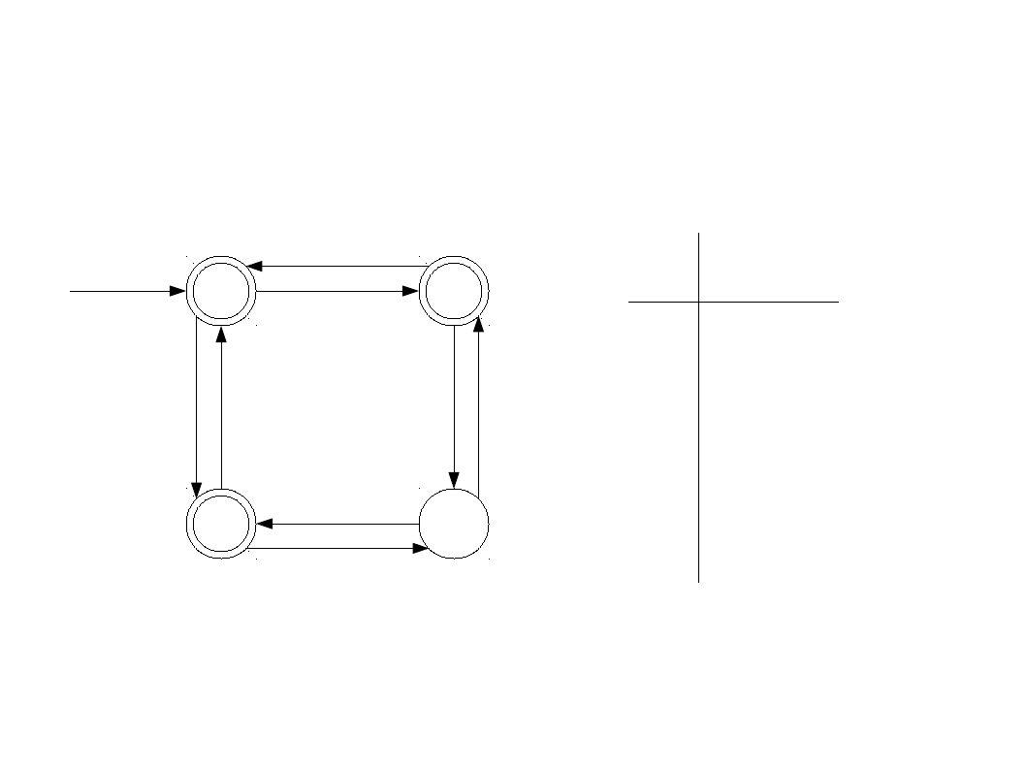
A Sample DFA
1
1
0
C
1
B
start
A
B
A
0
0
0
0
B
C
D
D
A
B
A
D
C
1
1
D
C

Slide 70
Code for DFAs
int kTransitionTable[kNumStates][kNumSymbols] = {
{2, 1, 3, 0, 0, 3, …},
…
};
bool kAcceptTable[kNumStates] = {
true,
true,
true,
false …
Runs in time O(m)
on a string of
Length m.
};
bool simulateDFA(string input) {
int state = 0;
for (char ch: input)
state = kTransitionTable[state][ch];
return kAcceptTable[state];
}

Slide 71
Speeding up Matching
In the worst-case, an NFA with n states takes time O(mn²) to match a string of length m.
DFAs, on the other hand, take only O(m).
There is another (beautiful!) algorithm to convert NFAs to DFAs.

